Slide 1

TRAVELOGUE
Pavithra V

Slide 2
Abstract
The number of people who loves travelling increases.
This causes for us to have a specified application to know the tourist spots in the area.
Now people uses websites like Google, Yahoo etc to search for the places that are good to visit either as a family or a single.
The proposed system “Travelogue” is used to view the tourist spot of interest.
The system uses common techniques for upload and retrieve data.

Slide 3
Proposed System
There is no particular website to suggest the tourist spot.
There are also applications like in Instagram and Facebook through which we can share our thoughts through post.
The proposed system is similar to that, I which the user has their own page where he/she can share their experience.
The big advantage is that we can know even the small spots and it is fully to suggest the tourist spots.

Slide 4
Web Application
Web Application
Registration
Registration
Login
Login
User
Can see other’s travel experience
Can upload their experience
Can see other’s travel experience
Can upload their experience

Slide 5
Web Application
Web Application
Registration
Login
Login
Can see other’s travel experience
Can upload the best event and contact personally
Admin
Can see other’s travel experience
Can upload their experience

Slide 6
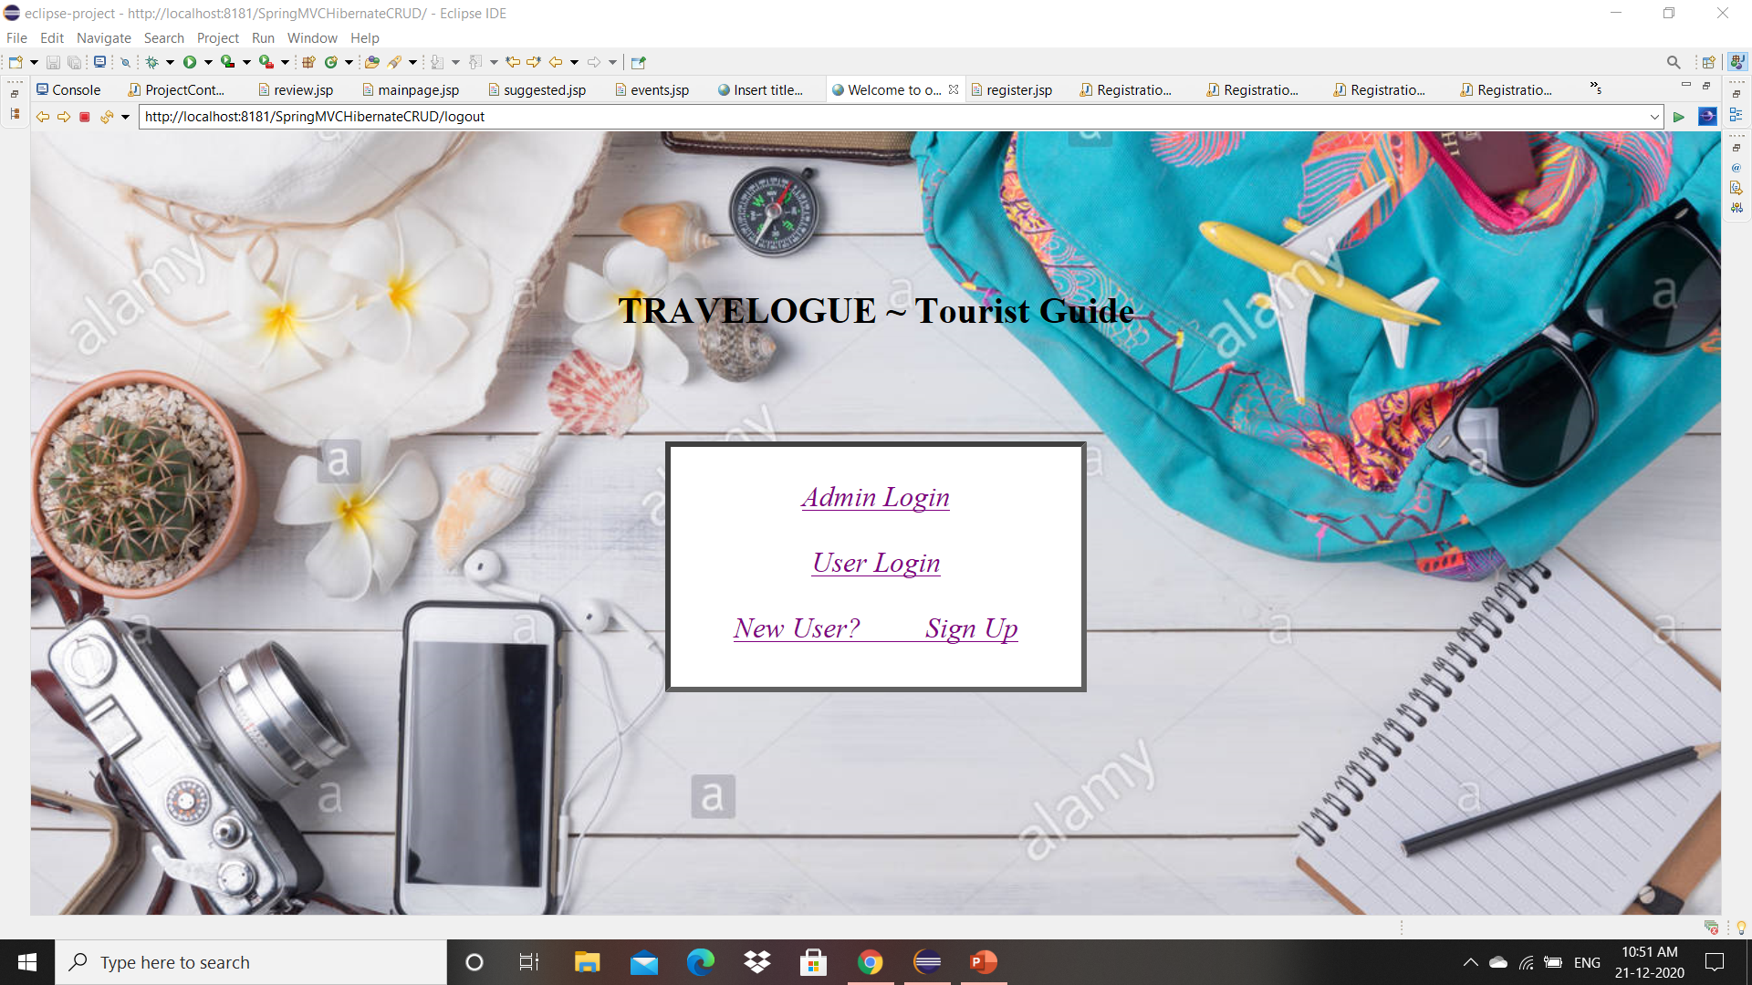
Fig 1. Front Page Of the Travelogue

Slide 7
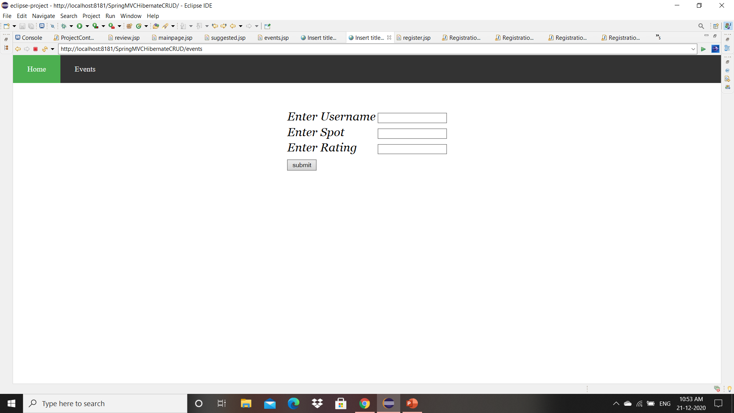
Fig 2. Admin Best Events Upload Page

Slide 8
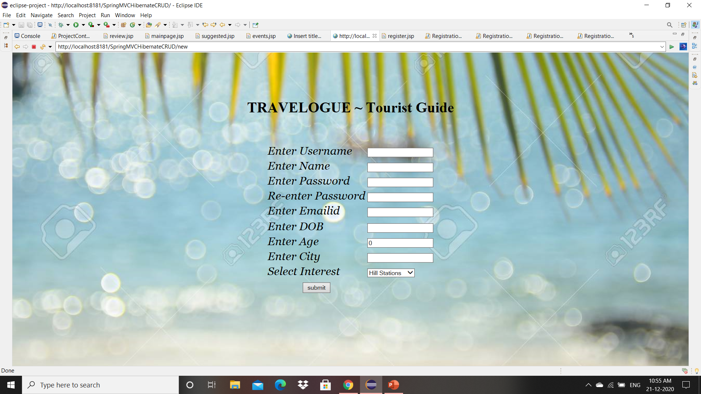
Fig 3. Registration page of the User

Slide 9
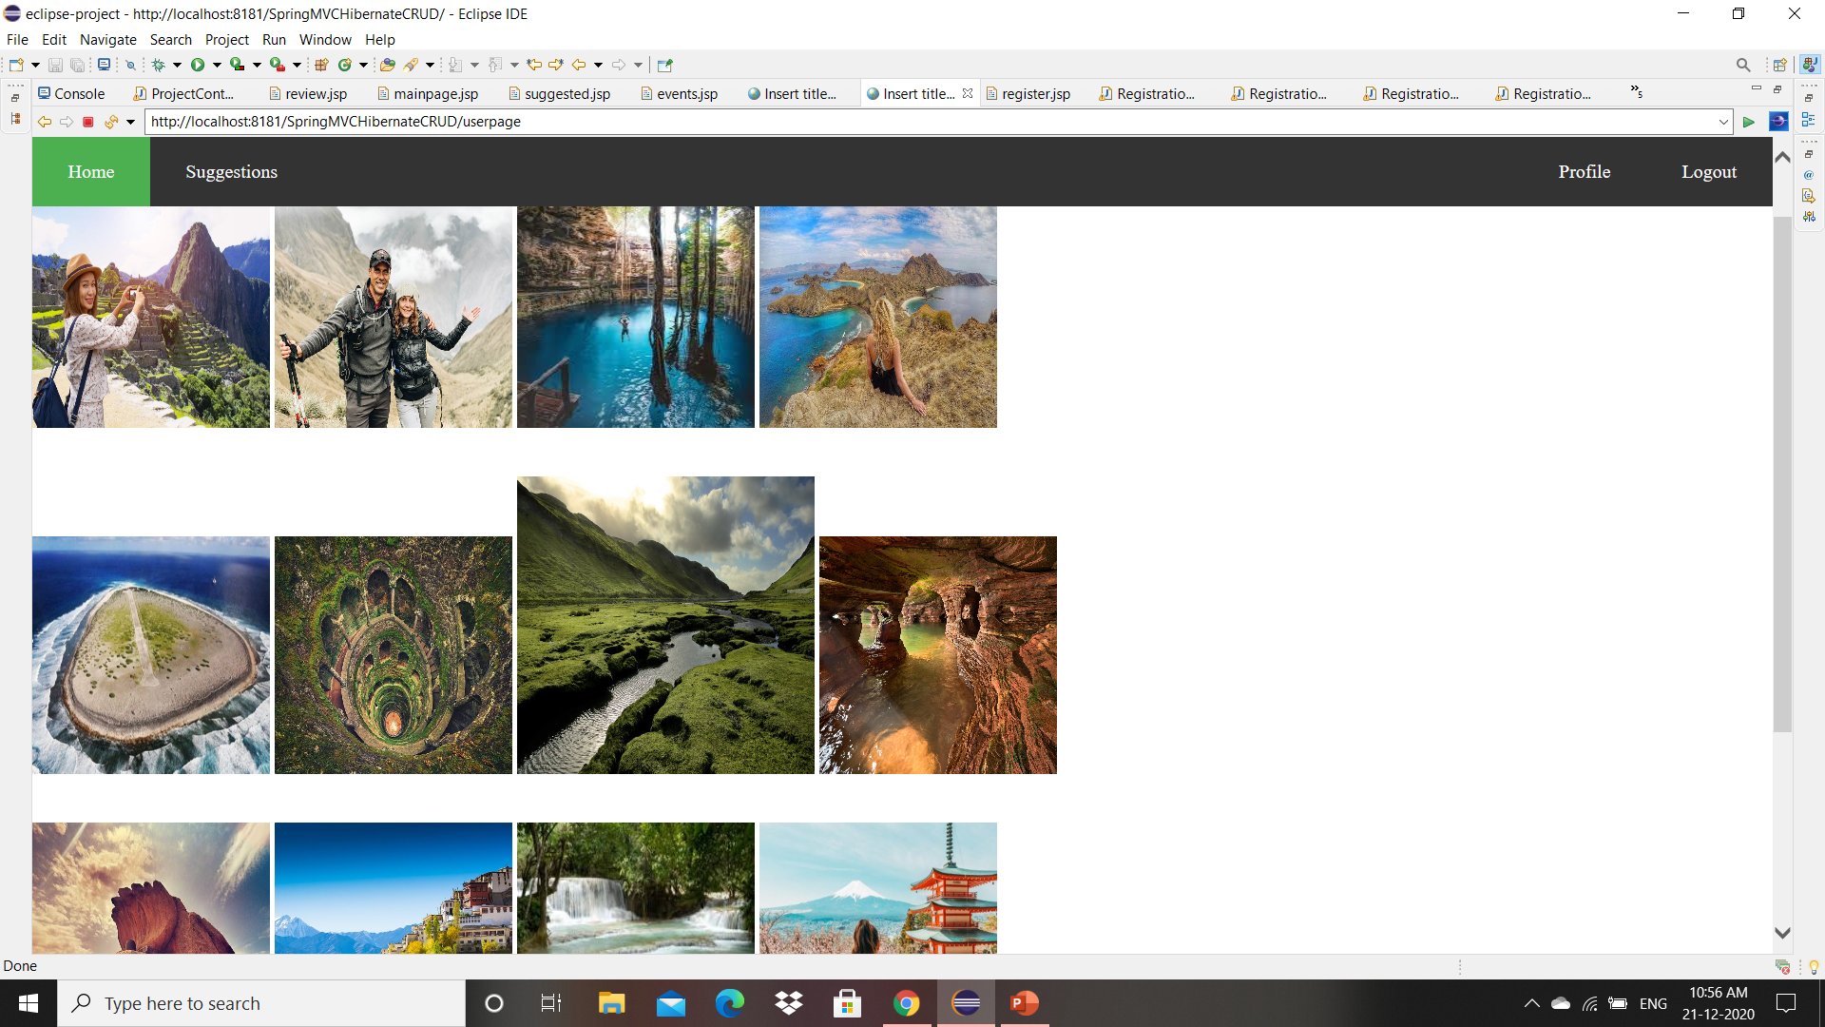
Fig 4. Home page of the User

Slide 10
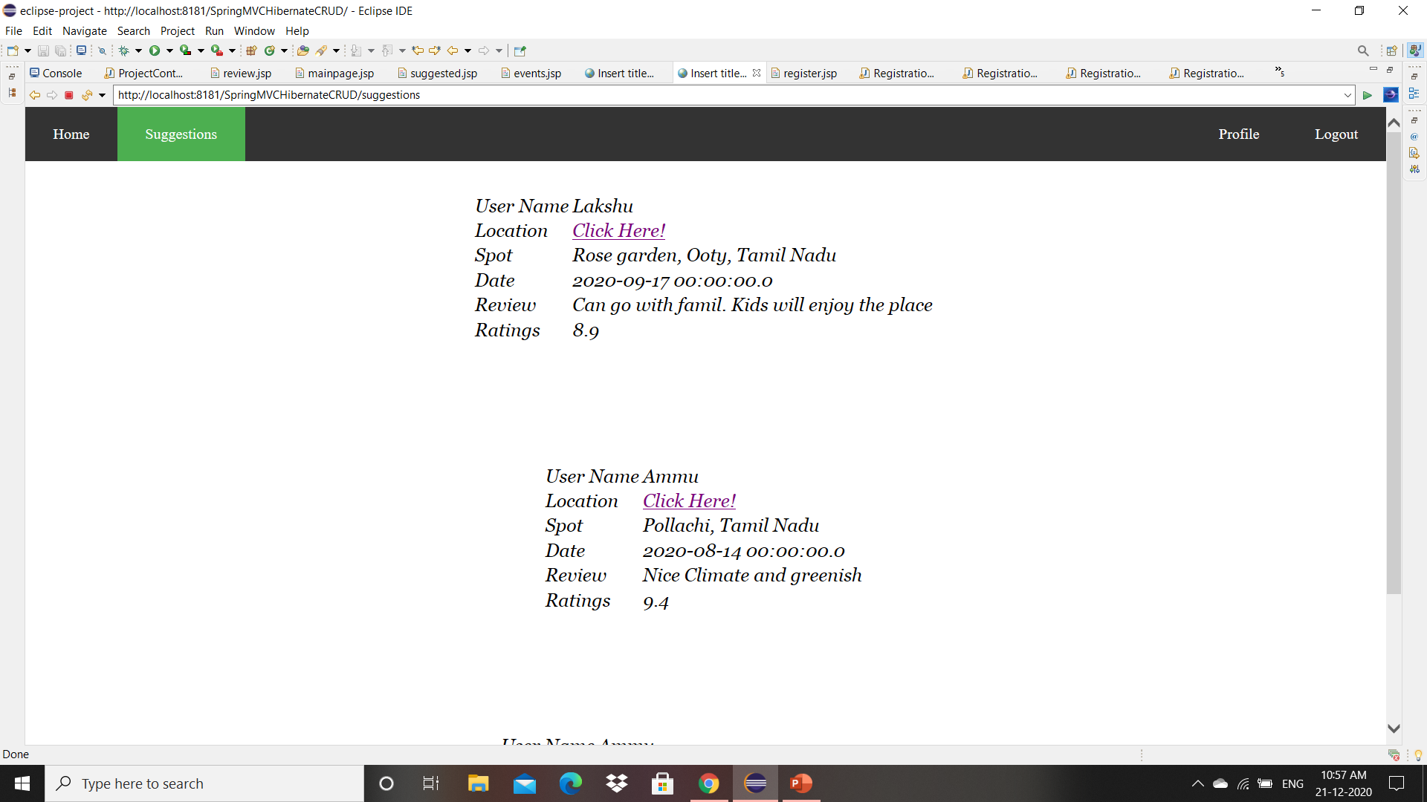
OUTPUT
Fig 5. Suggestion Page

Slide 11
Project Work Flow
The proposed project has two modules, Admin and User
The user registers and login to their page.
They may upload their review as suggestion to other users.
The most unvisted and unique user’s suggestion is selected.
The admin can also view the suggestions.

Slide 12
Thank You

